Slide 1
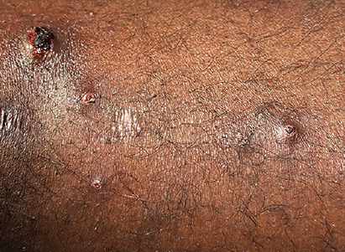
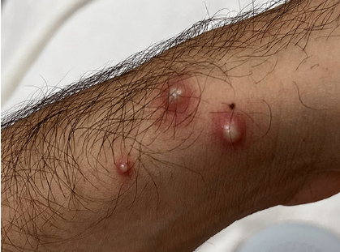
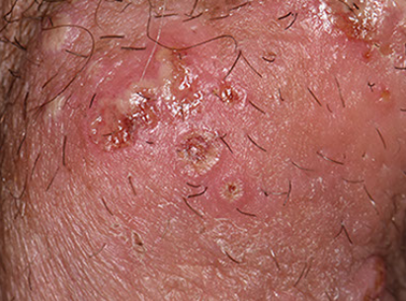
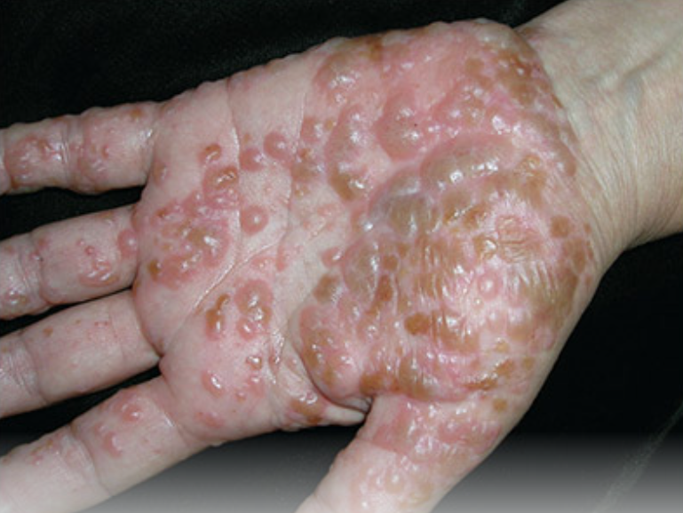
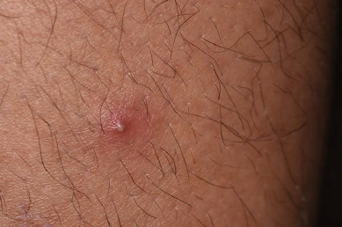
HELP DEM
RESEARCH
Contact x73115 for any rash!
Examples:
$10 Amazon Gift Card
ULCERATED
CRUSTED
ULCERATED
PUSTULAR
(or bullous)
EROSIVE
VESICULAR
PUSTULAR

